Slide 1
Analysis on SG Public Transport (Trains/Buses)
Tan Wen Tao Bryan (p2214449)
DAAA/FT/1B/01

Slide 2
Objectives
To find out the differences in bus routes that contains or do not contain interchange as well as during peak and off peak hour (in terms of distance and frequency of buses being dispatched for those routes).
To find out how advanced Singapore train network system is (in terms of daily ridership, daily distance covered and rail length) and how smooth the train operation is.

Slide 3
Nature of Cleaned Datasets
Distance travelled by buses, category, description of bus stops, presence of interchange, frequency of buses dispatched for peak and off peak periods
Rail length of MRT & LRT
Cleaned Dataset 1
Distance float64
Category (Trunk, Feeder, Express) object
Description object
Interchange (Have/Do Not Have) object
Freq_of_Buses_during_Peak_Period float64
Freq_of_Buses_during_OffPeak_Period float64
dtype: object
Cleaned Dataset 2
Rail Length (MRT) float64
Rail Length (LRT) float64
dtype: object
Ridership & Daily Distance Travelled by MRT & LRT
Distance travelled by MRT before major delays of more than 5 min for each line
Cleaned Dataset 3
Average Daily Distance (MRT) float64
Average Daily Distance (LRT) float64
Average Daily Ridership (MRT) int32
Average Daily Ridership (LRT) int32
dtype: object
Cleaned Dataset 4
North-South Line int64
East-West Line int64
North-East Line int64
Circle Line int64
Downtown Line int64
dtype: object

Slide 4
Cleaning Datasets (Buses)
Perform an inner merge on given original 3 dataframes into 1 final merged dataframe
Merge routes and services on=['ServiceNo','Operator','Direction'] columns
Merge previous merged dataset and bus stops on=['BusStopCode'] column
Set and sort ["ServiceNo","Direction","StopSequence"] as dataset indexes, so accessing visualising data is much clearer and neater due to these columns being unique
Fill up missing values with 0
[“AM_Peak_Freq”,”AM_Offpeak_Freq”,”PM_Peak_Freq”, ”PM_Offpeak_Freq”] have empty values, do not have buses dispatched during those time periods
Drop unused columns ["Latitude","Longitude","WD_FirstBus","WD_LastBus", "SAT_FirstBus","SAT_LastBus","SUN_FirstBus","SUN_LastBus", "LoopDesc"]
Formulated new columns
Use regex to check for Int in [“Description”], “Have Interchange” if have, else “Do Not Have Interchange” if do not have.
Form [“Freq_of_Buses_during_Peak_Period”, “Freq_of_Buses_during_OffPeak_Period”] by splitting values in [“Peak_Freq”, “Offpeak_Freq”] for AM & PM by “-” individually, retrieve first value for each column, get average of the AM & PM freq of buses dispatched for both Peak and Offpeak period.
Filter off rows of data for bus categories ["TRUNK","FEEDER","EXPRESS"] to focus on these bus routes

Slide 5
Cleaning Datasets (Trains)
Set and sort ["Year"] as dataset index by ascending order
Drop unused columns ['Rail Length (Kilometres)','Average Daily Ridership - Bus (Thousand Passenger-Trips)','Average Daily Trip - Point-To-Point (P2P) Transport (Taxis And Private Hire Cars) (Thousand Daily-Trips)']
Drop rows of data (1990, 1996, 1999)
Rename specific columns ex.(MRT km Operated -> Average Daily Distance (MRT))
Use .loc to retrieve specific columns in original dataframe to form 2 new dataframes
Rail Length MRT & LRT as 1 dataframe
Average Daily Distance, Average Daily Ridership MRT & LRT as 1 dataframe
Fill up missing values with interpolation in both directions to get best estimated values
Rail Length (2004 & 2006-2008)
Use .applymap() to calculate the average daily distance travelled for trains instead of total distance for the year
Use .astype(int) to convert the values from float to integer

Slide 6
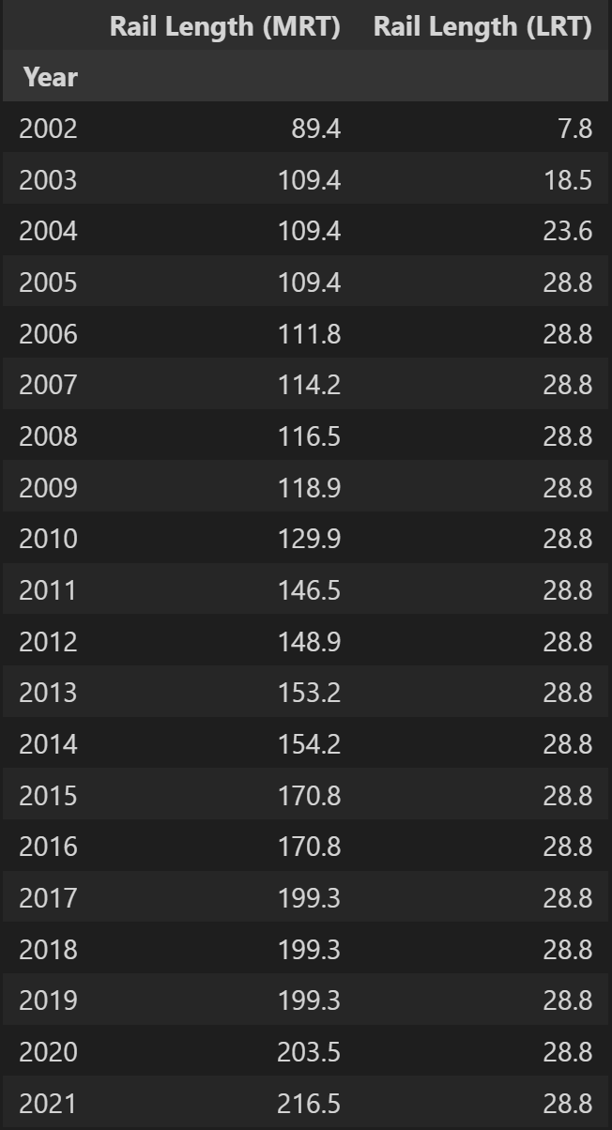
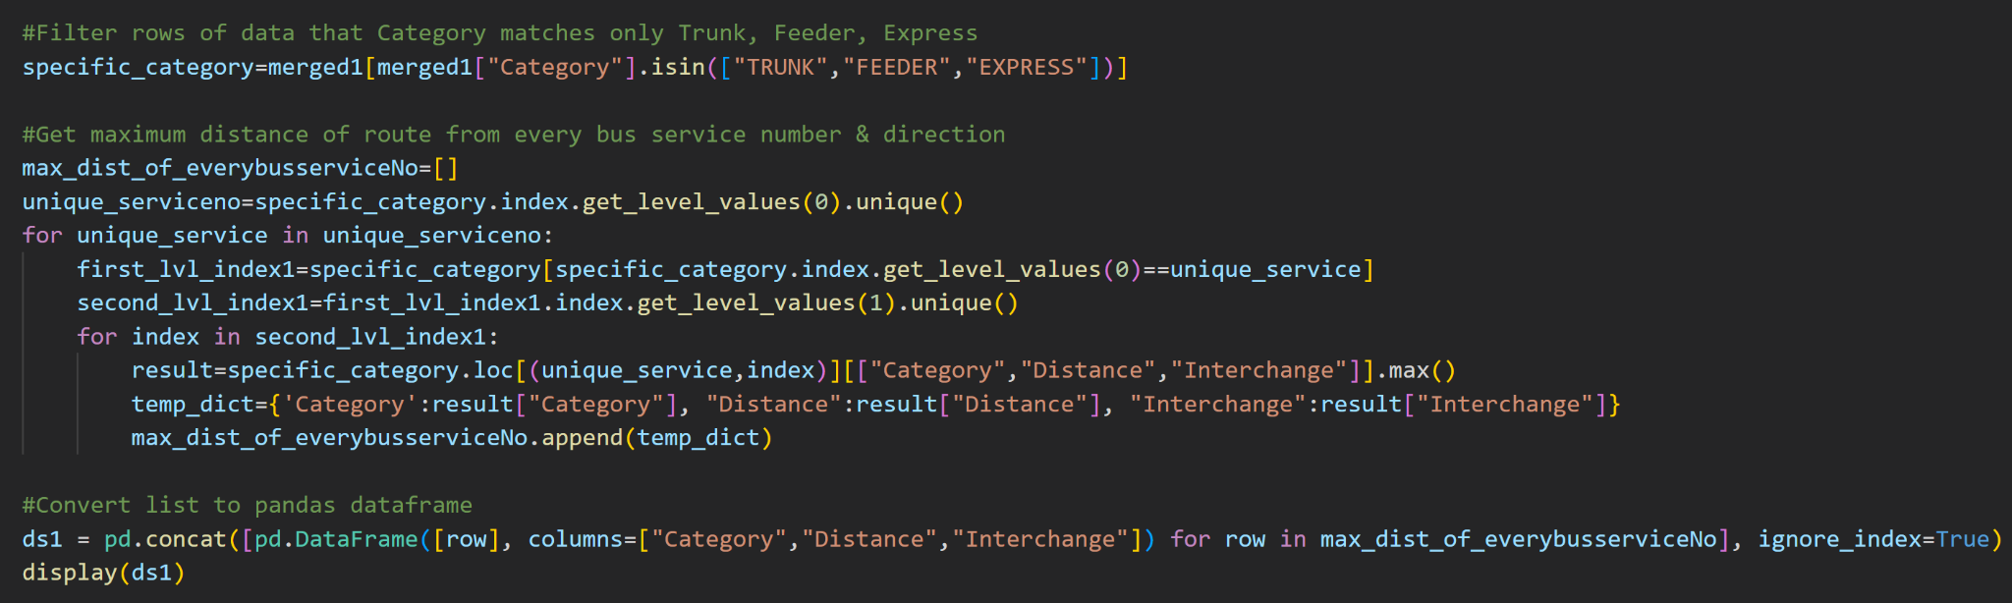
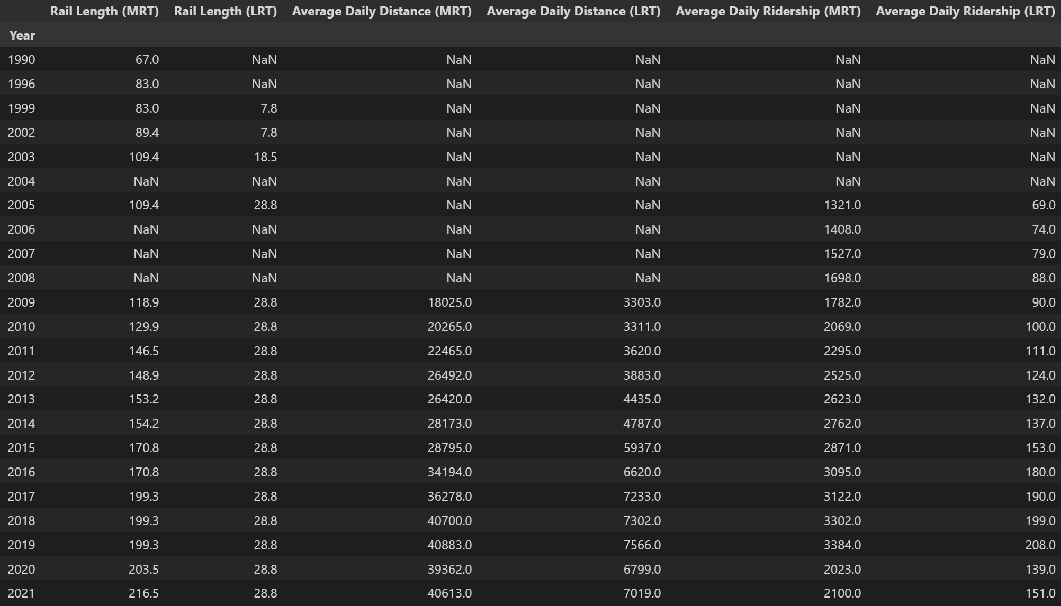
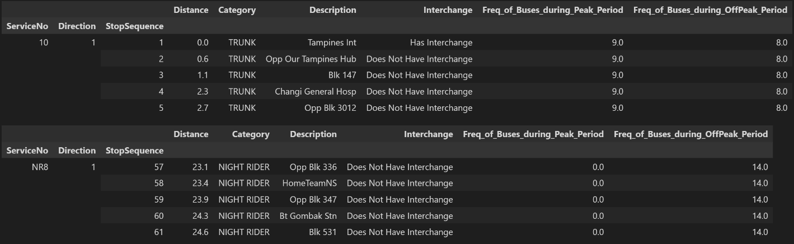
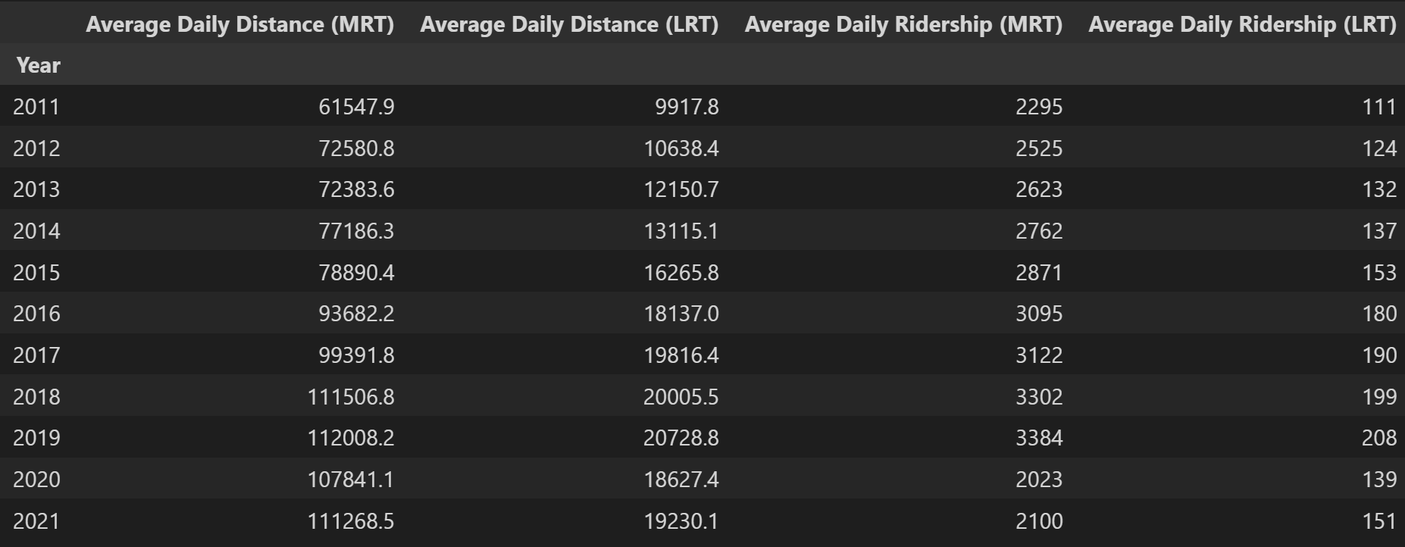
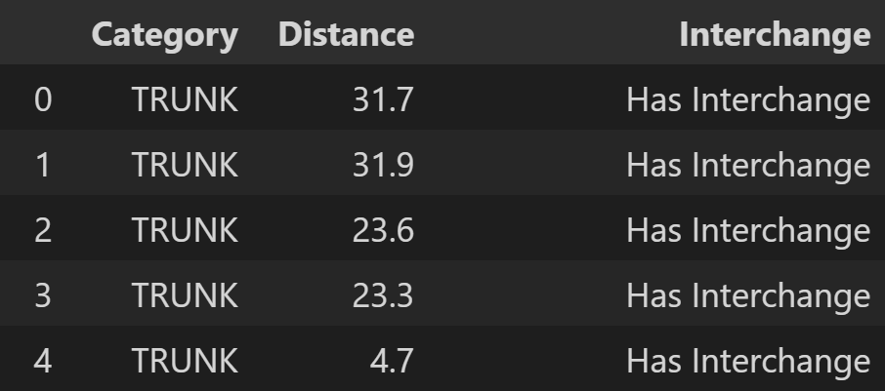
* This slide is animated (use slideshow to view full content)
Retrieve max distance for every Bus Route
to get distance of every Bus Route for each Bus Service & Direction
Finalised Merged Dataset 1
Dataset 2 (Before)
Dataset 2 (After) to form final dataframes 2&3
Use to plot first graph (same technique is used to plot other graphs)

Slide 7
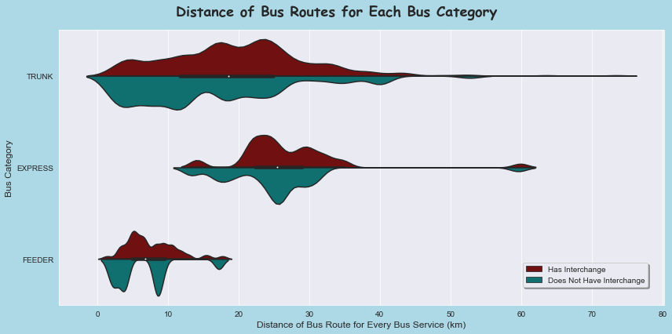
Distribution of Bus Route Distance for Feeder, Trunk & Express Buses
Looking at the median (white dot) of the bus routes distance, Express bus covers the largest distance, followed by Trunk bus and Feeder bus. Express Bus Routes usually has expressways, buses usually skips bus stops which covers longest distance naturally. Secondly, Trunk Bus Routes are longer as they connect different neighbourhoods or towns across the islands and also goes into the city areas. Lastly, Feeder Bus Routes operate around a neighbourhood, hence they are the shortest. (Land Transport Guru, 2022)
Generally, bus routes for Trunk and Express containing interchange has more routes with longer distances than those without interchanges.
Most unusual is the Feeder bus routes, where those that do not have interchange are split into 3 clusters, first is clustering around 1-5 km, second cluster which is largest around 8-11km and last clustering around 16-18km, whereas those with interchange are distributed rather consistent with 4-5 km at its peak.

Slide 8
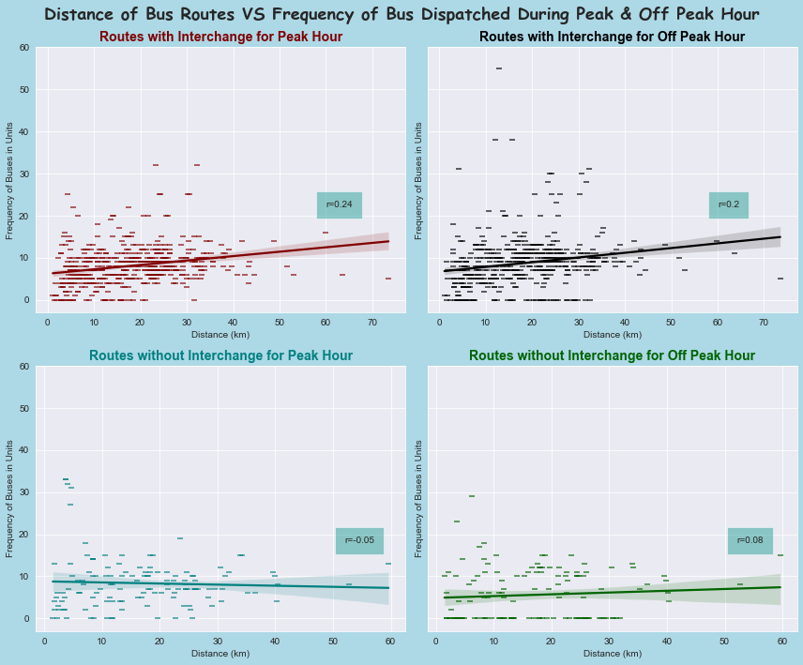
Distance of Bus Routes VS Frequency of Bus Dispatched During Peak & Off Peak Hour
Generally, for bus routes with interchange, the longer the distance of the routes, the greater the frequency of the buses being dispatched. They have a stronger correlation than routes without interchanges. This indicates that for bus routes with interchanges, more buses are dispatched for routes with longer distances. It is natural for this to happen as routes with interchanges mean more passengers taking buses, hence should have more buses dispatched, especially during peak hour. Hence, it still has a stronger correlation than that from the off peak hour.
In contrast, bus routes without interchanges either has a weak positive correlation or a negative correlation between distance and frequency of buses dispatched. This is also normal as the buses in supply will be dispatched for routes with interchange.

Slide 9
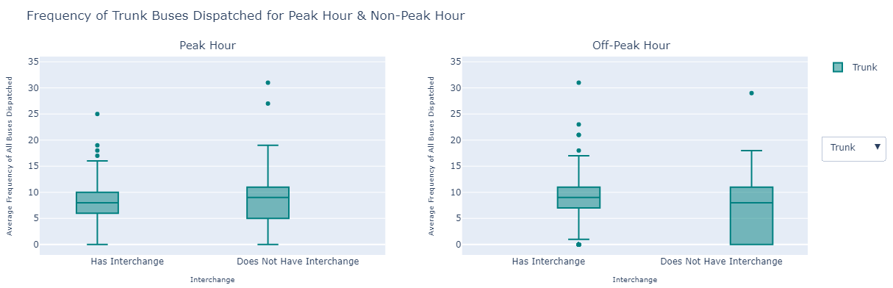
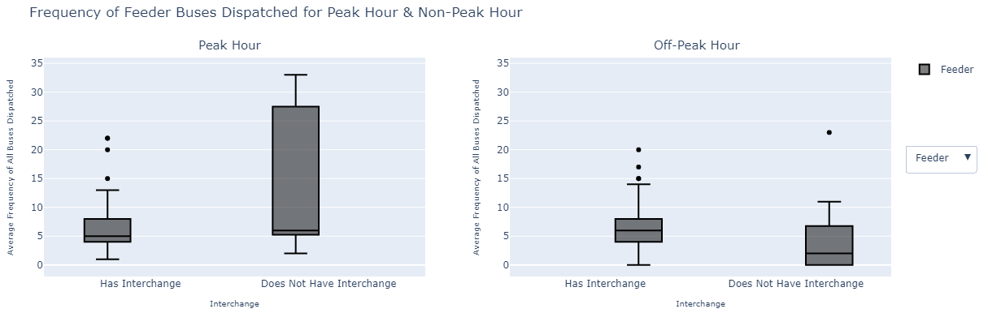
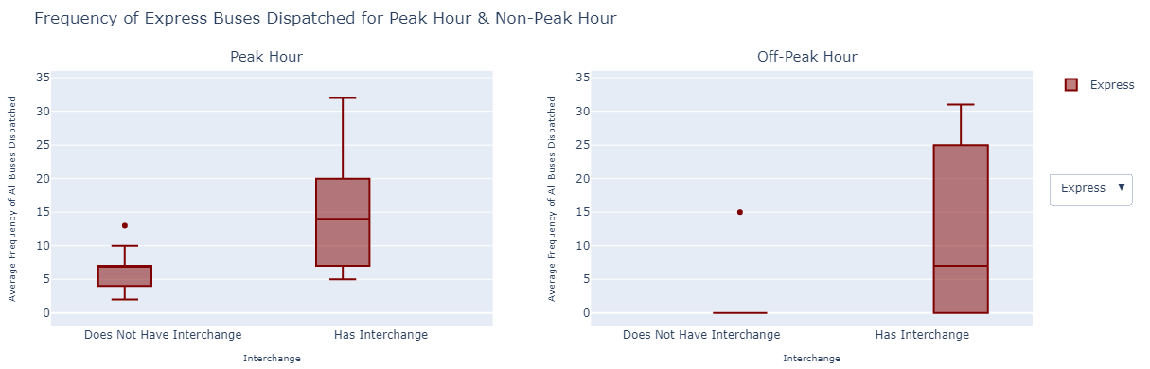
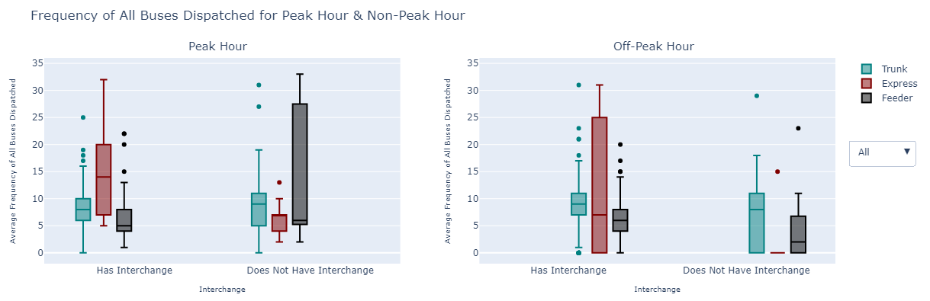
Frequency of Buses Dispatched for Peak VS Off Peak Hour
* This slide is animated (use slideshow to view full content)
Note that since there are too many variables to compare here, I have included a dropdown to focus the scope on 1 category at a time.
Just comparing peak and off peak hour, for Express bus routes, peak hour generally dispatch more buses than off peak hour. For Trunk bus routes, peak hour and off peak hour generally dispatch the same amount of buses. For Feeder bus routes during peak hour, bus routes with and without interchange dispatch generally the same amount of buses, while for off peak hour, routes without interchange generally dispatch fewer buses than those with interchange.
For Express bus routes, routes with interchanges has more buses dispatched than without interchange. For Trunk and Feeder bus routes, routes with interchanges have buses more consistently dispatched than without interchange. In conclusion, different bus categories can have different frequency of buses dispatched in peak and off peak hour.

Slide 10
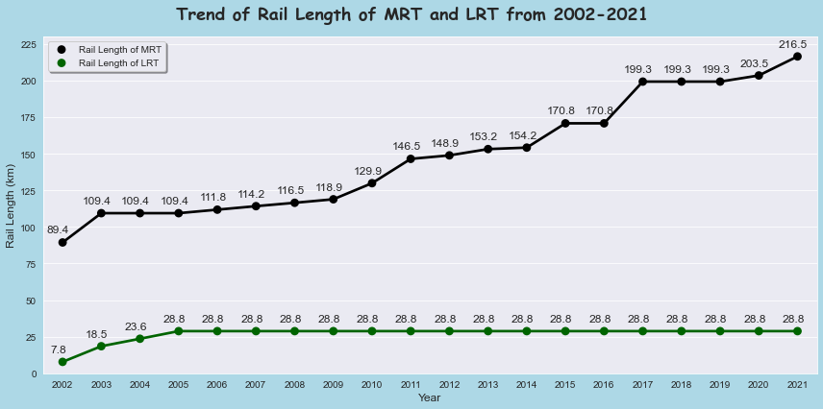
Trend of Rail Length for MRT & LRT from 2002-2021
It’s quite obvious that MRT rails are much longer than LRT rails as MRT connects neighbourhood and cities islandwide, while LRT only connects neighbourhood in specific parts of the island.
For MRT, the rail length has been increasing consistently with the steepest increase from 2016-2017. During the time, DTL 3 was being tunneled while rails connecting to train depots were being upgraded and extended too. Hence, there is a steep increase. Each time the rail length increases, it indicates that the train network has extended. (LTA, 2016)
For LRT, the rail length only increased in the beginning from 2002-2005, and became constant in the subsequent years. This is because Sengkang LRT line was being constructed at that time with East Loop being opened in 2003 and West Loop being opened in 2005. No extension to the LRT rail has been made since then. (Wikipedia, 2023)

Slide 11
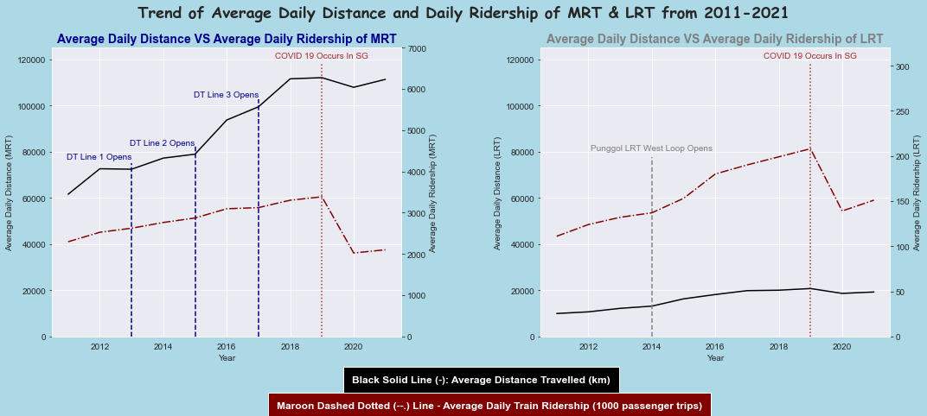
Trend of Average Daily Distance & Daily Ridership of MRT & LRT from 2011-2021
Black Solid Lines: Average distance travelled by the trains
Red Dashed Dotted Lines: Daily Trains Ridership per 1000 passenger trips
Generally, for both the average daily distance and daily ridership, MRT has a way larger measure than LRT. It is quite expected as the MRT network system is much larger and it connects from cities to neighbourhoods islandwide while LRT runs within the neighbourhood. This will also indicate that fewer people will take the LRT as compared to MRT, especially since MRT network also connects to the CBD district. As seen in 2020, there was a huge drop in the average daily train ridership. COVID 19 broke out in Singapore and with Circuit Breaker & many other policies implemented to restrict people from going out to work, a drop in ridership is expected. In 2021, ridership improved but it did not recover to its original state due to Work From Home still taking place.
Average distance travelled by the trains increased drastically in some years was due to new train lines becoming accessible to public.

Slide 12
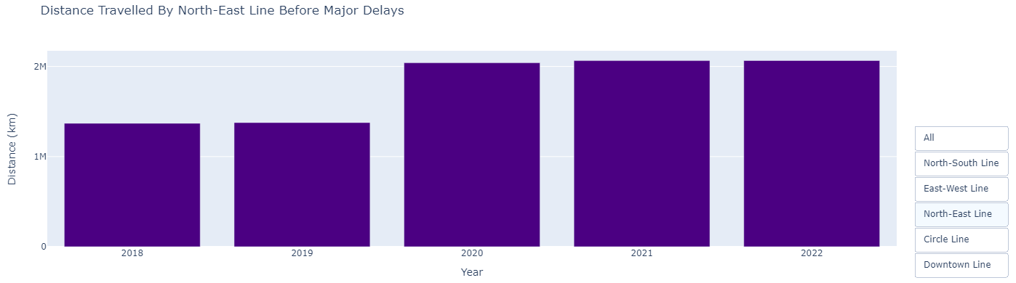
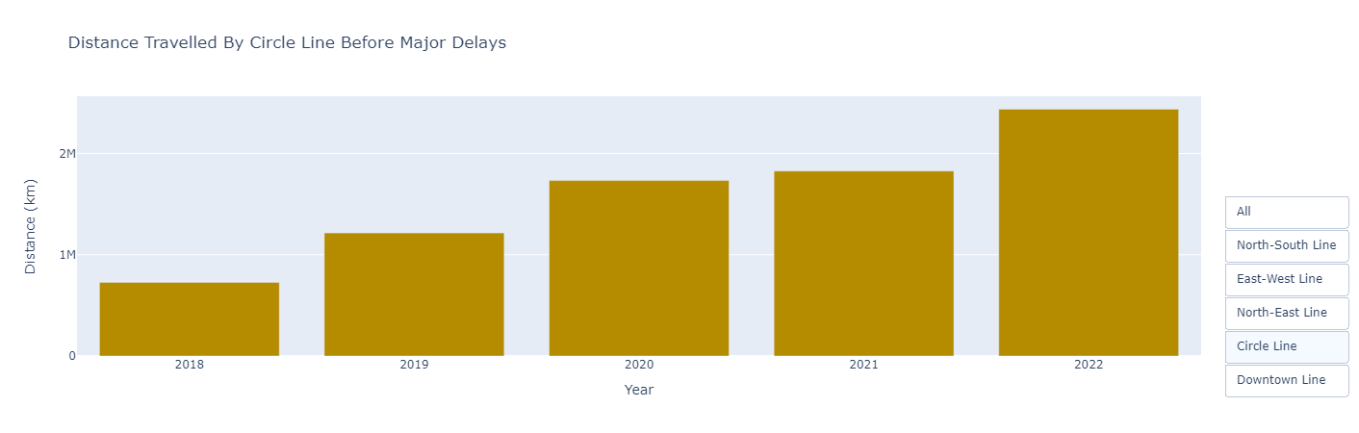
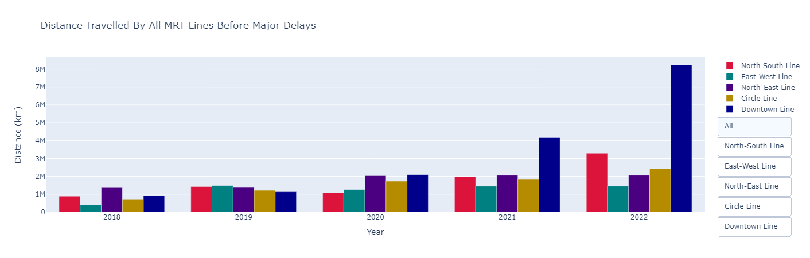
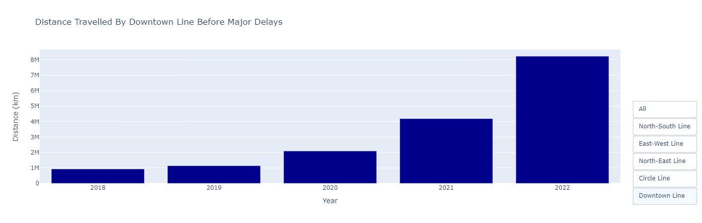
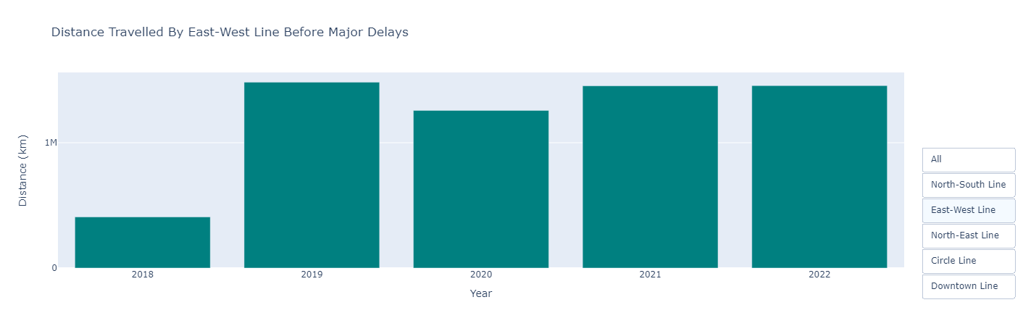
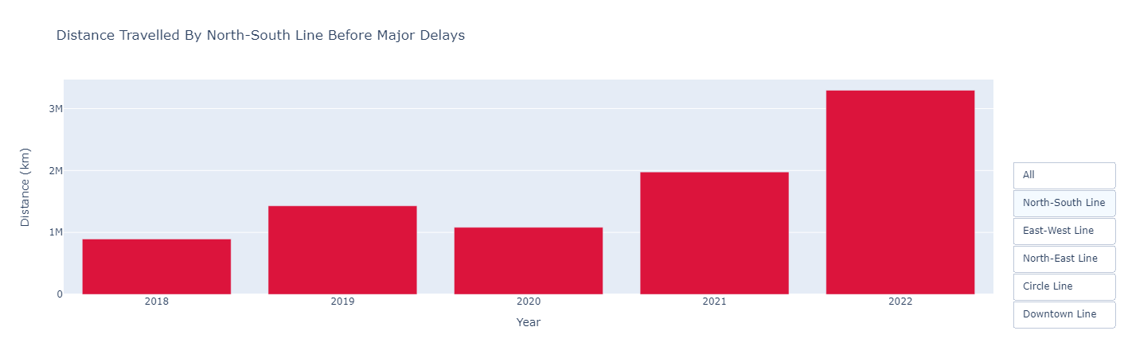
Reliability of MRT Lines Across 2018-2022
* This slide is animated (use slideshow to view full content)
From 2018-2022, the distance travelled by each MRT line have improved with the exception of the East West Line, all the train lines have went above the 2M mark but East-West line is still below the 2M mark and it has been approximately the same in previous years. North-East Line did not improve much from previous years too but it is still more reliable than the East-West Line. Ultimately, Downtown Line has been the most reliable since 2020 and the difference in reliability with the other lines has just became more significant in 2021 and 2022. (More than 2x the distance compared to other lines and improvement from 2021) In contrast, East-West Line has been the least reliable line.
In 2020 & 2021, the North-East Line was second in terms of reliability and North-South Line was third. In 2022, North-South Line won over North-East Line in reliability and improved by 1.5x from 2021. Circle Line won North-East Line in 2022.

Slide 13
Conclusion 1
Express bus routes cover the longest distance, followed by Trunk then Feeder buses.
Bus routes with interchanges are generally longer than bus routes without interchanges, there are exceptions such as some of the Feeder bus routes.
For bus routes with interchanges, the longer the distance, the greater the frequency of buses being dispatched.
For bus routes without interchanges, this might not be true as the buses in supply will be dedicated to bus routes with interchange due to the higher number of passengers there.
For Express bus routes, more buses are dispatched during peak hour compared to off peak hour.
For Trunk bus routes, approximately the same amount of buses are being dispatched for peak and off-peak hour.
For Feeder bus routes, there isn’t a clear pattern as to how buses are being dispatched.
It is most likely that the frequency of buses differ in each individual bus routes.
Recommendation 1: In order to strengthen Singapore bus services, LTA should build up Singapore bus supply so that the bus operators have more buses to dispatch for bus routes that connects to interchanges. Even though the regression plot has proved that the longer the distance, the greater the frequency of buses being dispatched, it was a weak correlation. So, more bus dispatched for those routes would increase the correlation.

Slide 14
Conclusion 2
Singapore MRT network system is very advanced and constantly expanding which will soon connect islandwide, whereas LRT network system has stopped expanding since 2005.
In 2020, Singapore MRT & LRT daily average ridership dropped significantly due to COVID 19 policies and Circuit Breaker and the levels are slowly recovering.
Average distance travelled by the MRT is increasing more drastically than LRT as they introduced more MRT lines to the public, resulting in greater frequency of trains being dispatched.
Average distance travelled by the LRT is increasing less drastically as LRT network system has remained stagnant, it interconnects with fewer neighbourhoods hence have a smaller ridership and distance travelled than MRT.
In terms of reliability levels, Downtown Line is the most reliable and East-West line is the least reliable.
Circle Line and North-South Line have been improving whereas East-West line and North-East line have not been improving over the last few years.
Singapore overall train network system and reliability has been quite advanced over the years, however some MRT lines reliability can still be improved.
Recommendation 2: In order to strengthen Singapore MRT reliability, SMRT and SBS should maintain the East-West line and North-East line more frequently to reduce the chances of future breakdowns and delays, which would make the train operation much more smoother.

Slide 15
Thank You!

Slide 16
References (Original Datasets)
Buses Routes, Services & Stops (Dataset 1,2,3)
Gowtham, V., 2019. Singapore Bus Data (Land transport authority) [online]. kaggle. Available from: https://www.kaggle.com/datasets/gowthamvarma/singapore-bus-data-land-transport-authority?select=bus_routes.csv [Accessed at 20 Jan 2023]
MRT/LRT Rail length, Daily Ridership & Distance Covered (Dataset 4)
Department of Statistics Singapore, 2022. Public Transport Operation And Ridership [online]. Available from: https://tablebuilder.singstat.gov.sg/table/TS/M651351#! [Accessed at 20 Jan 2023]
MRT Distance Travelled Before Delays of More Than 5 Mins (Dataset 5)
Yong, C., 2022. Reliability of MRT network hit new high in first quarter of 2022; only 1 major breakdown [online]. Available from: https://www.straitstimes.com/singapore/reliability-of-mrt-network-hit-new-high-in-first-quarter-of-2022-only-1-major-breakdown [Accessed at 20 Jan 2023]
Insights References
Land Transport Guru, 2023. Basic Bus Services [online]. Available from: https://landtransportguru.net/basic-bus-services/#:~:text=Trunk%20services%20are%20spread%20all,spoke%20transport%20system%20of%20Singapore. [Accessed at 20 Jan 2023]
LTA, 2016. The Rail Report: New Signalling System, Rail Line and Extension and Trains Next Year [online]. Available from: https://www.lta.gov.sg/content/ltagov/en/newsroom/2016/10/2/the-rail-report-new-signalling-system-rail-line-and-extension-and-trains-next-year.html [Accessed at 28 Jan 2023]
Wikipedia, 2023. Light Rail Transit (Singapore) [online]. Available from: https://en.wikipedia.org/wiki/Light_Rail_Transit_(Singapore) [Accessed at 28 Jan 2023]

